Slide 1

INVESTMENT
PORTFOLIO
PROPOSAL
Sara Maria Joy | Athira John | Radhika Puri | David Ogbeide

Slide 2


Stock Selection
National Budget
Targeted Industry
Stock
Top Funded Sectors
Top Down
Approach

Slide 3


Sector(s): Technology Industry: Semiconductors
Stock: Broadcom Inc. (AVGO)
Sector(s): Consumer Defensive Industry: Discount Stores
Stock: Costco Wholesale Corporation (COST)
Sector(s): Consumer Defensive Industry: Education & Training Services
Stock: Stride, Inc. (LRN)
Sector(s): Healthcare Industry: Diagnostics & Research
Stock: Thermo Fisher Scientific Inc. (TMO)
Key Considerations
Total Revenue
Total Profit
P/E Ratio
Free Cash Flow
Current Ratio
Beta

Slide 4
Competitive Analysis
BETA | EPS | P/E | CURRENT RATIO
Semiconductors
NVIDIA
AVGO
AMD
1.69 | 7.58 | 63.44 | 3.59
1.12 | 32.94 | 31.25 | 2.82
1.67 | 0.11 | 1256.27 | 2.19
Diagnostics & Research
0.86 | 7.92 | 27.95 | 2.26
0.83 | 15.25 | 32.46 | 1.63
1.23 | 9.81 | 56.84 | 1.43
DHR
TMO
IDXX
Discount Stores
0.77 | 14.16 | 44.06 | 1.07
0.81 | 5.27 | 24.76 | 1.36
O.49 | 6.01 | 25.63 | 0.85
COST
DLTR
WMT
Education & Training
LRN
GHC
LOPE
0.34 | 3.62 | 16.81 | 3.61
1.04 | 33.48 | 19.45 | 1.56
0.68 | 6.37 | 22.17 | 2.76

Slide 5
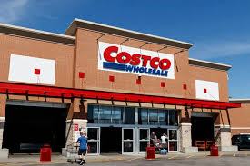
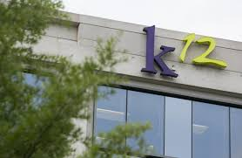
Costco Wholesale Corporation
Costco Wholesale Corporation is a leading international retailer with over 800 warehouses worldwide, known for its membership-based business model and diverse product offerings. Iin 2023, Costco reported over $242 billion in annual sales, indicating strong growth and market presence, particularly in groceries, electronics, and furniture. The company is celebrated for its ethical business practices and commitment to providing high-value products at low prices.
Stride, Inc.
Stride, Inc., formerly known as K12 Inc., provides online and blended education services and curricula for pre-K through 12th grade. It is a technology-based education company that offers proprietary and third-party curricula, software systems, and educational services. Stride's mission is to help students reach their full potential through inspired teaching and personalized learning.

Slide 6

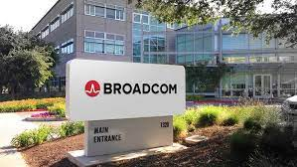
Thermo Fisher Scientific Inc.
Thermo Fisher Scientific Inc. is a leading global provider of scientific instrumentation, reagents and consumables, and software services. It is known for its contributions to life sciences research, diagnostics, and industrial applications. Thermo Fisher is acclaimed for innovation in the scientific community, providing advanced analytical instruments and laboratory equipment, including those for genetic testing and mass spectrometry.
Broadcom Inc.
Broadcom Inc. is a global technology leader that designs, develops, and supplies a broad range of semiconductor and infrastructure software solutions. It serves the data center, networking, software, broadband, wireless, and storage and industrial markets. With approximately 20,000 employees, Broadcom operates in over 30 countries. In 2023, the company reported revenues of $35.8 billion.

Slide 7
PESTLE ANALYSIS
Factor | AVGO | COST | LRN | TMO
Political | Tax policies, trade laws, regulations, and political stability all affect the company's profitability and operations in different regions. | This includes government policies, political stability, and international relations. | Government education policies and funding, state-level regulations, political stability. | Regulatory compliance, taxation, trade policies, and political stability.
Economic | Global economic conditions, the cost of raw materials, and labor costs are significant to Broadcom's financial health. | Costco is influenced by the global economy, stability of product prices, and the purchasing power of customers. | Market conditions, income distribution, global economic trends. | Global economic conditions, inflation, interest rates, and currency exchange rates.
Social | Emphasis on diversity and inclusion, technological literacy, consumer behavior, and sustainability shape how Broadcom approaches its market and workforce. | Commitment to employee welfare, community engagement, and sustainable business practices are important. | Diversity and inclusion, educational trends, social attitudes, demographic shifts. | Aging population, health consciousness, environmental awareness, and education levels.
Technological | Advancements in wireless technology and R&D investments drive Broadcom's product innovation and competitiveness. | Technological advancements, inventory management systems, and e-commerce expansion are key focuses. | Online learning platforms, AI and machine learning, data security, infrastructure, mobile learning. | R&D investment, technology advancements, and the need for continuous innovation.
Environmental | The company's commitment to reducing its carbon footprint and implementing energy-efficient practices are essential for sustainable operations. | The company is impacted by climate change, environmental regulations, and sustainability initiatives. | Climate change, environmental regulations, sustainability. | Climate change, energy consumption, waste management, and biodiversity impact.
Legal | Compliance with intellectual property laws, data protection regulations, and antitrust laws are critical for lawful operations. | Costco adheres to labor, product safety, intellectual property, and data protection laws. | Education sector regulations, labor laws, multi-state compliance. | Health and safety, environmental laws, labor laws, and antitrust regulations.

Slide 8
SWOT ANALYSIS
Factor | AVGO | COST | LRN | TMO
Strengths | Strong Financial Performance, Diverse Product Portfolio, Established Customer Base, Commitment to R&D, Acquisition Capabilities | Loyal Customer Base Doesn’t waste money on advertising High-Quality Products | Innovation-led culture. Superior customer experience. Competitive pricing strategies. | Market leadership in life sciences. Strong R&D capabilities.
Weaknesses | Reliance on advertising revenue, privacy concerns, ongoing legal and regulatory scrutiny. | Limited Product Selection Cost of Transportation Slow eCommerce Adoption | Strategy-communication misalignment among employees. Extended cash cycle necessitates better cash flow management. Supply chain vulnerability to global disruptions. | Dependence on major customers. Substantial debt.
Opportunities | Expansion in Cloud Computing, Advancements in AI and Autonomous Technology, Growth in Digital Services. | expansion of online presence and eCommerce platform. Global expansion and tapping into the growing health-conscious market. | Business model reconfiguration. Automation in manufacturing. Expansion of online learning. | Expansion into emerging markets. New product development.
Threats | Competitive pressure from other tech giants, changing regulatory landscapes, data privacy issues. | Brand reputation risks and intense competition from other retailers. Fake products | Climate change disruptions. Lowering barriers to entry in education. | Competitive industry landscape. Regulatory hurdles.

Slide 9
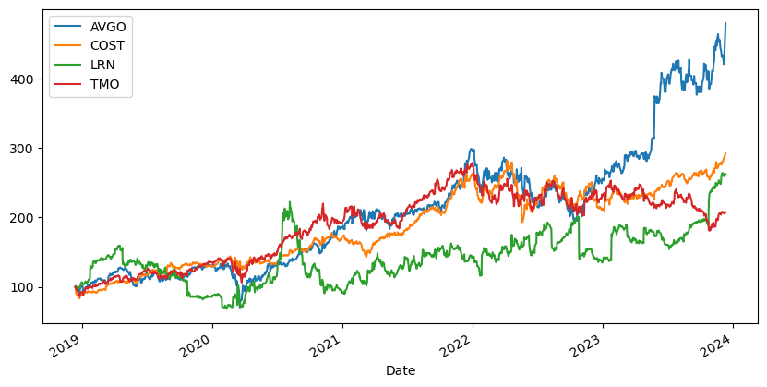
Monte Carlo Simulation Results
Past performance of stocks
STOCKS | Open Price | Avg Predicted Price In 1 Year
AVGO | $ 1084.04 | $ 1316.36
COST | $ 635.98 | $ 703.93
TMO | $ 501.10 | $ 544.00
LRN | $ 60.86 | $ 64.99
As of December 13, 2023
12.30.00 PM

Slide 10
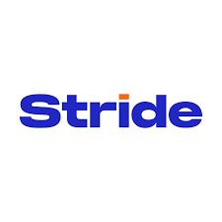


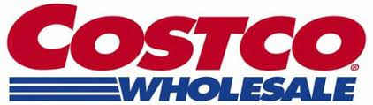
Portfolio Correlation
 | AVGO | COST | LRN | TMO
AVGO | 1.00 | 0.50 | 0.18 | 0.44
COST | 0.50 | 1.00 | 0.11 | 0.47
LRN | 0.18 | 0.11 | 1.00 | 0.14
TMO | 0.44 | 0.47 | 0.14 | 1.00

Slide 11
Weight Allocation For Optimized Portfolio
(based on Sharpe Ratio)
The Sharpe Ratio is a measure of the risk-adjusted return of an investment or a portfolio. It was developed by Nobel laureate William F. Sharpe and is widely used to assess the performance of an investment by taking into account its risk.

Slide 12
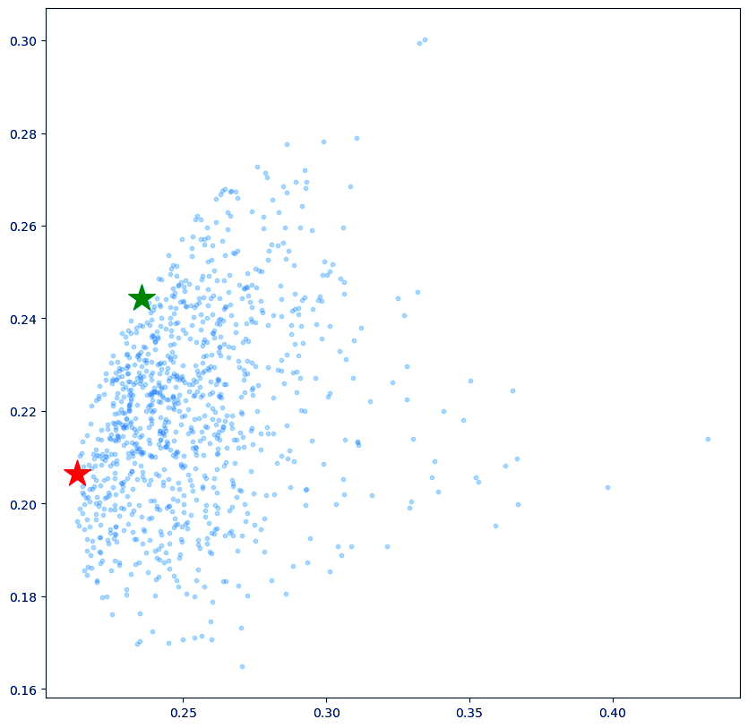


Optimized Portfolio
Annual Expected Returns: 24.44%
Annual Volatility: 23.55%

Slide 13

THANK YOU

